Slide 1
Evaluation of (n,xγ) data
Richard B. Firestone
University of California, Berkeley
Lawrence Berkeley National Laboratory
Berkeley, CA 94720, USA
IAEA Specialized Workshop on NSDD Evaluations
Vienna, Austria, 27-29 April 2015

Slide 2
General Motivations
Neutron reaction data are important for applications in nuclear physics, chemistry, and engineering. They should be evaluated to produce complete, adopted (n,xγ) datasets.
Results from different neutron reactions should not be combined.
Gamma-ray intensities should be normalized to obtain P_{γ} values.
Cross section normalizations should be given when available.
Reduced photon strengths should be calculated.

Slide 3
Thermal (n,γ) Data
A single dataset containing primary and secondary γ-rays on the same intensity scale should be constructed.
Intensities should be normalized to give both P_{γ} and σ_{γ} using the following primary references
Zs. Revay and G. L. Molnar, Standardisation of the prompt gamma activation analysis method, Radiochim. Acta 91, 361–369 (2003).
Database of Prompt Gamma Rays from Slow Neutron Capture for Elemental Analysis, STI/PUB/1263,ISBN 92–0–101306–X, International Atomic Eneregy Agency, Vienna, 2007, http://www-pub.iaea.org/MTCD/publications/PDF/Pub1263_web.pdf.
Zs. Revay et al, Handbook of Prompt Gamma Activation Analysis, ed. G.L. Molnar, Kluwer Academic Publishers, Dortrecht, 2004.
F. De Corte and Andras Simonits, Recommended nuclear data for use in the k₀ standardization of neutron activation analysis, At. Data Nucl. Data Tables 85, 47–67 (2003) .
S.F. Mughabghab, Atlas of Neutron Resonances, Elsevier, 2006.
P_{γ}=σ_{γ}/σ₀
σ_{γ} from references 1-4, σ₀ from reference 5 or evaluation.

Slide 4
Thermal (n,γ) Data
A summary of previous σ₀ measurements, compiled from EXFOR and NSR, should be given in the comments.
Mughabghab’s recommended σ₀ value should be given in the comments.
S_{n} should be calculated by a least-squares fit of primary γ-rays to the level scheme and compared with the AME value.
Expected mulipolarities, based on J^{π} of final level, M1, E1, or E2 should be given for primary γ-rays.
The effective spin and parity of the capture state should be given in the J^{π} field based on σ_{γ}(±) from Mughabghab’s Atlas. There should be a comment discussing the relative spin and parity contributions.
¹⁵⁶Gd example
Mughabghab Atlas
156GD L 8536.20 5 2- 0.110 eV 3
156GD cL J$|s{-|g}(2-)=60874 b, |s{-|g}(1-)=14 b (2006MUZX)

Slide 5
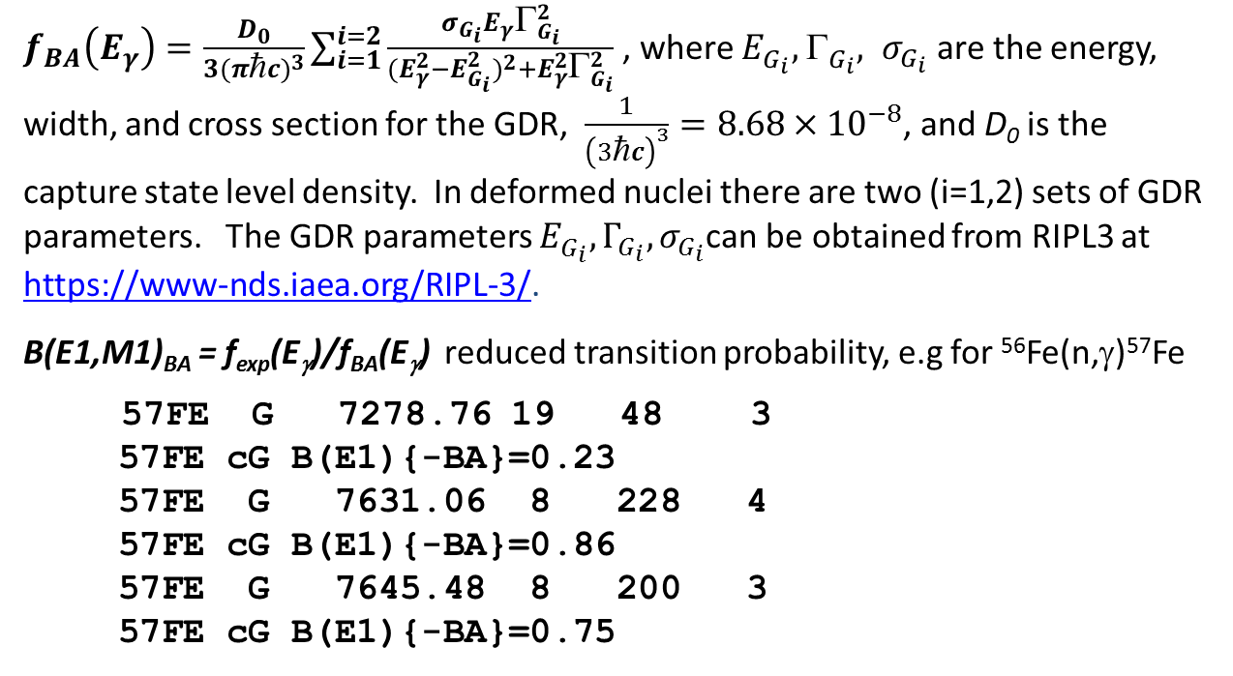
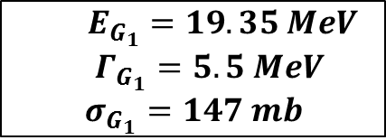
Thermal (n,γ) Data
Calculate reduced transition probabilities for primary γ-rays. Use Brink-Axel E1 calculation rather than Weisskopf single particle estimates.
$$f_{exp}\left(E_{γ}\right)=P_{γ}\left\langle Γ_{γ^{0}}\right\rangle /{E_{γ}}^{3}$$
, , where P_{γ} is the transition probability per decay, ⟨Γ_{γ0}⟩ is the capture state width, and E_{γ} is the γ-ray energy in MeV.
$f_{BA}\left(E_{γ}\right)=\frac{D_{0}}{3(πηc)^{3}}\sum_{i=1}^{i=2}{\frac{σ_{G_{i}}E_{γ}Γ_{G_{i}}^{2}}{(E_{γ}^{2}−E_{G_{i}}^{2})^{2}+E_{γ}^{2}Γ_{G_{i}}^{2}} }$, where $E_{G_{i}}^{}, { }_{G_{i}}^{}, σ_{G_{i}}$ are the energy, width, and cross section for the GDR, $\frac{1}{{\left(3ηc\right)}^{3}}=8.68×{10}^{−8}$, and D₀ is the capture state level density. In deformed nuclei there are two (i=1,2) sets of GDR parameters. The GDR parameters $E_{G_{i}}^{},Γ_{G_{i}}, σ_{G_{i}}$can be obtained from RIPL3 at https://www-nds.iaea.org/RIPL-3/.
B(E1,M1)_{BA} = f_{exp}(E_{γ})/f_{BA}(E_{γ}) reduced transition probability, e.g for ⁵⁶Fe(n,γ)⁵⁷Fe
57FE G 7278.76 19 48 3
57FE cG B(E1){-BA}=0.23
57FE G 7631.06 8 228 4
57FE cG B(E1){-BA}=0.86
57FE G 7645.48 8 200 3
57FE cG B(E1){-BA}=0.75
$E_{G_{1}}=19.35 MeV$
$Γ_{G_{1}}=5.5 MeV$
$$σ_{G_{1}}=147 mb$$

Slide 6
Thermal (n,γ) Data

Slide 7
Thermal (n,γ) Data
The Rydberg-Ritz Combination Principle is the theory proposed by Walter Ritz in 1908 to explain the relationship of the spectral lines for all atoms. The principle states that the spectral lines of any element include frequencies that are either the sum or the difference of the frequencies of two other lines.
This method is used by authors and evaluators in reverse to find new (n,γ) levels but it is not generally valid due to the complexity of the spectrum.
For example in ⁵⁶Fe(n,γ)⁵⁷Fe we resolve 449 γ-rays from 0-7646 keV, for an average separation of 17 keV. There is a 1/17 chance that a transition energy will match a level energy difference within 1 keV.
With the aid of coincidence data 32 levels in ⁵⁷Fe previously assigned by energy sums and adopted in ENSDF were found not to exist.
Do not adopt levels found by energy sums unless
Their existence is confirmed by other reaction measurements
At least 3-4 interconnecting transitions can be found whose energies match well

Slide 8
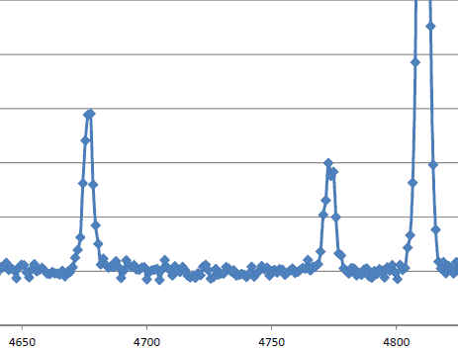
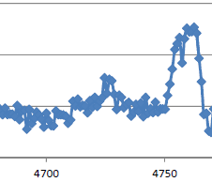
Thermal (n,γ) Data
Sum coincidence, E_{sum}=7646.
4725.69(24) keV γ-ray from ⁵⁶Fe(n,γ)
Previously placed as primary E1 γ-ray populating 2920.56-keV level
E_{γ}(calc)=4725.62 keV
Not observed in coincidence with 2920.56-keV γ-ray!
Alternative placement from 6252.85(5) keV (1/2,3/2,5/2⁺) level to 1627.29(2) keV 3/2⁻ level
E_{γ}(calc)=4725.56(5) keV
Transition observed in coincidence with the 1627.29 keV γ-ray!
E_{γ}=4726 keV
Sum coincidence,
E_{sum}=7646-1627
E_{γ}=4726 keV

Slide 9
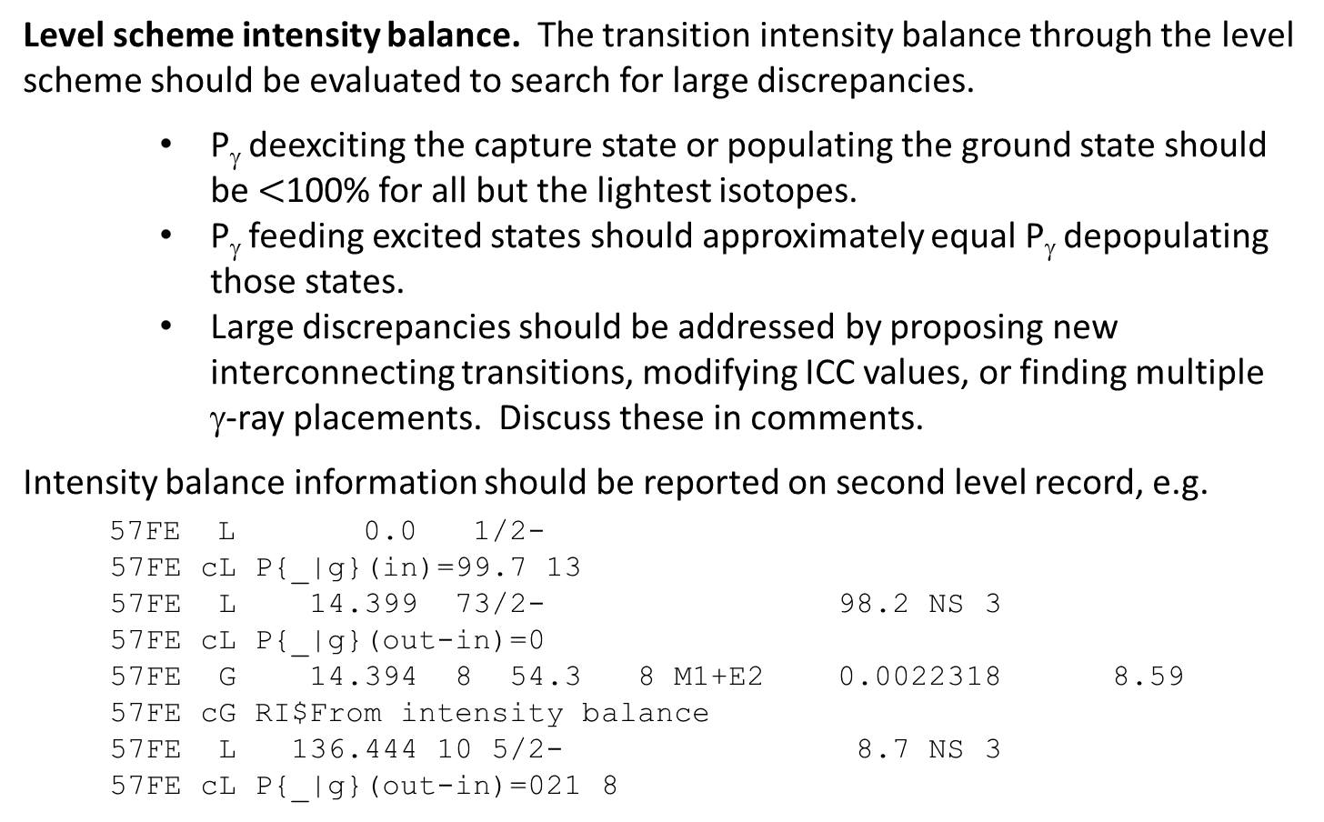
Thermal (n,γ) Data
Level scheme intensity balance. The transition intensity balance through the level scheme should be evaluated to search for large discrepancies.
P_{γ} deexciting the capture state or populating the ground state should be $<$100% for all but the lightest isotopes.
P_{γ} feeding excited states should approximately equal P_{γ} depopulating those states.
Large discrepancies should be addressed by proposing new interconnecting transitions, modifying ICC values, or finding multiple γ-ray placements. Discuss these in comments.
Intensity balance information should be reported on second level record, e.g.
57FE L 0.0 1/2-
57FE cL P{_|g}(in)=99.7 13
57FE L 14.399 73/2- 98.2 NS 3
57FE cL P{_|g}(out-in)=0
57FE G 14.394 8 54.3 8 M1+E2 0.0022318 8.59
57FE cG RI$From intensity balance
57FE L 136.444 10 5/2- 8.7 NS 3
57FE cL P{_|g}(out-in)=021 8

Slide 10
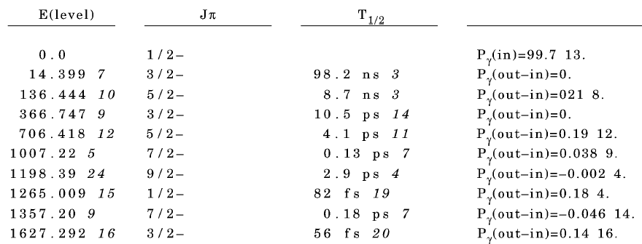
Thermal (n,γ) Data

Slide 11
Thermal (n,γ) Data
Statistical model considerations: Evaluators should take into account the statistical population/depopulation of (n,γ) levels. A formal calculation with DICEBOX is desirable but beyond the feasibility of most evaluators.
Some statistical considerations can be made without formal calculations.
(n,γ) will populate all low-lying levels with J^{π}=J^{π}(CS)±1 with comparable intensities to nearby levels of the same spin. Levels not populated either don’t exist or have different spins.
(n,γ) will populate low-lying levels with J^{π}=J^{π}(CS)±2,3 with significantly lower intensity.
(n,γ) will populate all low-lying levels with J^{π}=J^{π}(CS)±4,5 very weakly if at all.

Slide 12
Thermal (n,γ) Data
¹⁸⁶W(n,γ) feeding intensity patterns can be used by evaluators to constrain J^{π} values.
A.M. Hurst et al, Phys. Rev. C 89, 014606 (2014)

Slide 13
(n,γ) activation data
Adopted activation decay dataset should be extended to include
Adopted (n,γ) production cross section
Individual γ-ray cross sections from references 2 and 4.
Normalization to k₀ value from references 2 and 4.
Decay scheme normalization should be compared with normalization derived from σ_{γ} data were
P_{γ}=σ_{γ}/σ₀
Activation γ-ray cross sections have been observed in EGAF measurements and are reported by de Corte and Simonits.
Some precise 4πβ−γ measurements have been found to be inaccurate.

Slide 14
ARC (n,γ) Data
ARC data experimentally invoke the statistical properties of photon strengths to distinguish M1 from E1 strength assuming s-wave capture. See
L. M. Bollinger and G. E. Thomas, Average-Resonance Method of Neutron-Capture y-Ray Spectroscopy: States of ¹⁰⁶Pd, ¹⁵⁶Gd, ¹⁵⁸Gd, ¹⁶⁶Ho and ¹⁶⁸Er, Phys. Rev, C2, 1951 (1970).
Intensities frequently given as I_{γ}/E_{γ}³ or I_{γ}/E_{γ}⁵ should be corrected to I_{γ}.
Evaluator should recheck J^{π} arguments based on ARC. Comparison should be based on I_{γ}/E_{γ}³, not I_{γ}/E_{γ}⁵ , or better by f_{γ}/f_{BA}.
An intensity normalization to per 100 neutron captures should be given either from experiment or calculated based on (n,γ) thermal data as follows.
$$N=100×\sum_{1}^{i}{{P_{γ_{i}}}^{ARC}/\sum_{1}^{i}{{P_{γ_{i}}}^{Th}}}$$
Summed over primary γ-rays to matching levels in thermal and ARC data.
Calculate reduced transition probabilities f_{γ}.
Mulipolarities should be given on γ-ray records.’
Capture state energy uncertainty should span ARC resonance region.

Slide 15
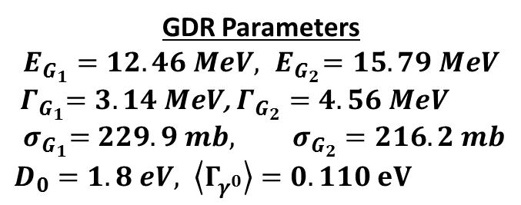
ARC (n,γ) Data
¹⁵⁶Gd ARC capture states have J^{π}=1⁻,2⁻. Favored transitions to levels with J=1,2 can be populated from both capture states and should have twice the population as levels with J=0,3 which can only be populated by one of the states.
$$f_{BA}\left(E_{γ}\right)=\frac{D_{0}}{3(πηc)^{3}}\sum_{i=1}^{i=2}{\frac{σ_{G_{i}}E_{γ}Γ_{G_{i}}^{2}}{(E_{γ}^{2}−E_{G_{i}}^{2})^{2}+E_{γ}^{2}Γ_{G_{i}}^{2}} }$$
$$f_{exp}\left(E_{γ}\right)=P_{γ}\left\langle Γ_{γ^{0}}\right\rangle /{E_{γ}}^{3}$$
GDR Parameters
$$E_{G_{1}}=12.46 MeV,{ E}_{G_{2}}=15.79 MeV$$
${ Γ}_{G_{1}}=3.14 MeV$, $Γ_{G_{2}}=4.56 MeV$
$${ σ}_{G_{1}}=229.9 mb, σ_{G_{2}}=216.2 mb$$
$D_{0}=1.8 eV, \left\langle Γ_{γ^{0}}\right\rangle =0.110 eV$
L. M. Bollinger and G. E. Thomas, Average-Resonance Method of Neutron-Capture y-Ray Spectroscopy: States of ¹⁰⁶Pd, ¹⁵⁶Gd, ¹⁵⁸Gd, ¹⁶⁶Ho and ¹⁶⁸Er, Phys. Rev, C2, 1951 (1970).

Slide 16
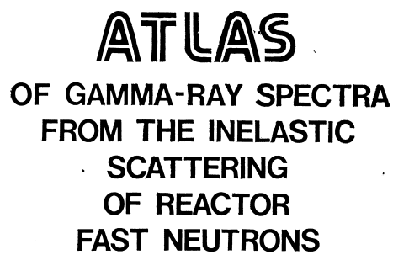
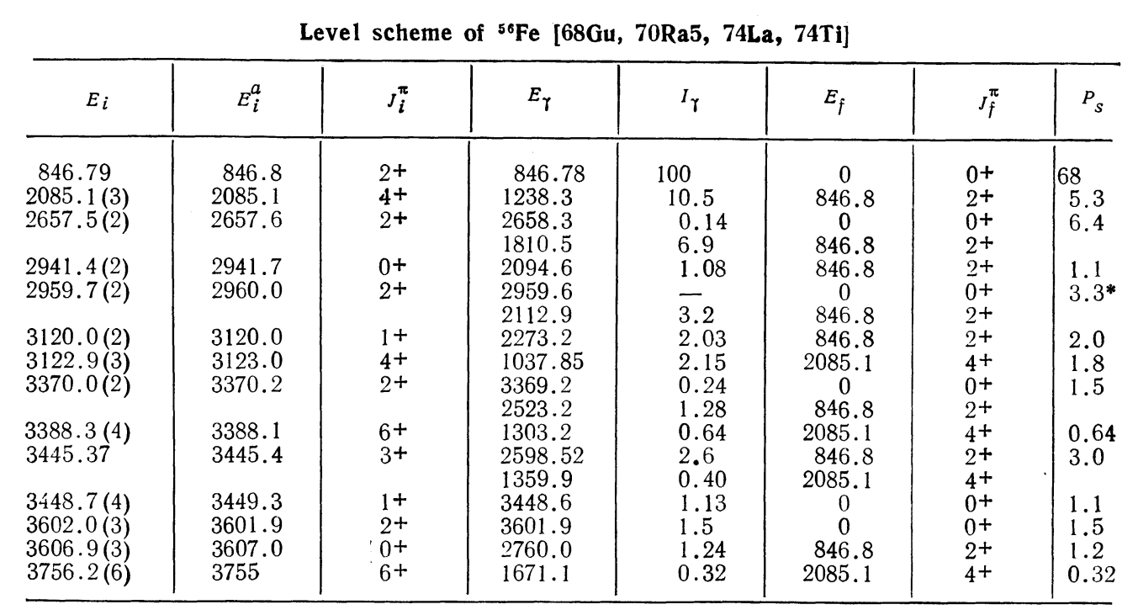
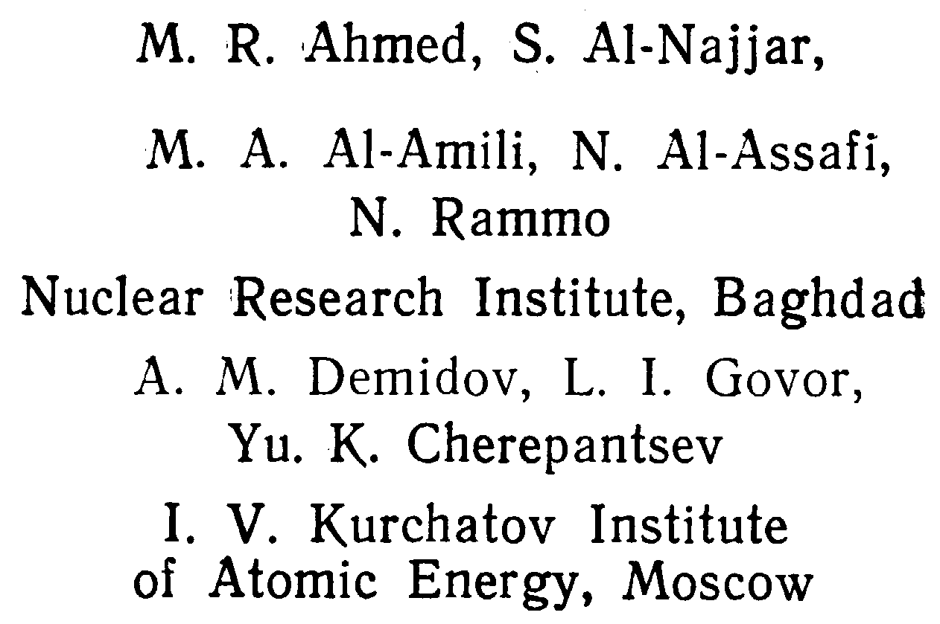
(n,n’γ) data
Separate datasets for each experiment
Baghdad Atlas data (1978De41)
Add missing γ-rays from Adopted Levels, Gammas
Normalize data to per 100 reactions, $\sum{I_{γ}\left(GS\right)=100}$
Give normalization with respect to 847 keV γ-ray from ⁵⁶Fe(n,n’γ) using Baghdad Atlas.
Give data on experimental neutron spectrum
This reaction is not selective so all levels of comparable spin should be populated. Adopted levels not seen in (n,n’γ) are questionable.

Slide 17
(n,n’γ) data
For ⁵⁶Fe inelastic scattering there is little selectivity for populating levels with J^{π}=1-4⁺ with fission neutrons. All levels in this spin range should be populated.

Slide 18
Resonance capture (n,γ) data
Evaluate like (n,γ) thermal data
Normalize like ARC data
Calculate reduced transition probabilities f_{γ}
Multiple resonance (n,γ) datasets can be combined for ARC analysis.
Resonance parameters
Include resonance properties and all data for all resonances from Mughabghab Atlas.
Updating should be left to reaction evaluation community.

Slide 19
Dissemination of (n,xγ) data
The (n,xγ) database will be edited and evaluated by the UCB/LBNL/LLNL Bay Area Nuclear Group (BANG) and provided to the IAEA for dissemination.
EGAF – thermal P_{γ}, σ_{γ}, σ₀, S_{n}, and activation data will be provided for future updates of the IAEA database https://www-nds.iaea.org/pgaa/.
EGAFNN – (n,n’γ) P_{γ}, σ_{γ} data will be provided to the IAEA, beginning with the Baghdad Atlas, as a subset of EGAF.
EGAFRES – ARC and resonance (n,γ) P_{γ} data will be evaluated and provided to the IAEA as a subset of EGAF.
ENSDF – complete Adopted Levels, Gammas evaluations will be performed on (n,γ) and (n,n’γ) isotopes and submitted for inclusion into ENSDF.
RIPL – ENSDF evaluations will be modified to conform to the needs of the RIPL file in collaboration with the IAEA.
Interested collaborators are encouraged to join the (n,xγ) evaluation effort.

